Slide 1
Kou 的跳躍擴散模型擴展：將雙伽瑪分佈的跳躍大小納入。 An Extension of Kou’s Jump-Diffusion Model to Incorporate Double-Gamma Distributed Jump Sizes
指導教授：呂育道 博士，繆維中 博士
台大財金所 R10723059 胡祖望

Slide 2
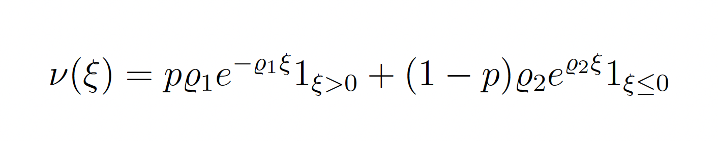
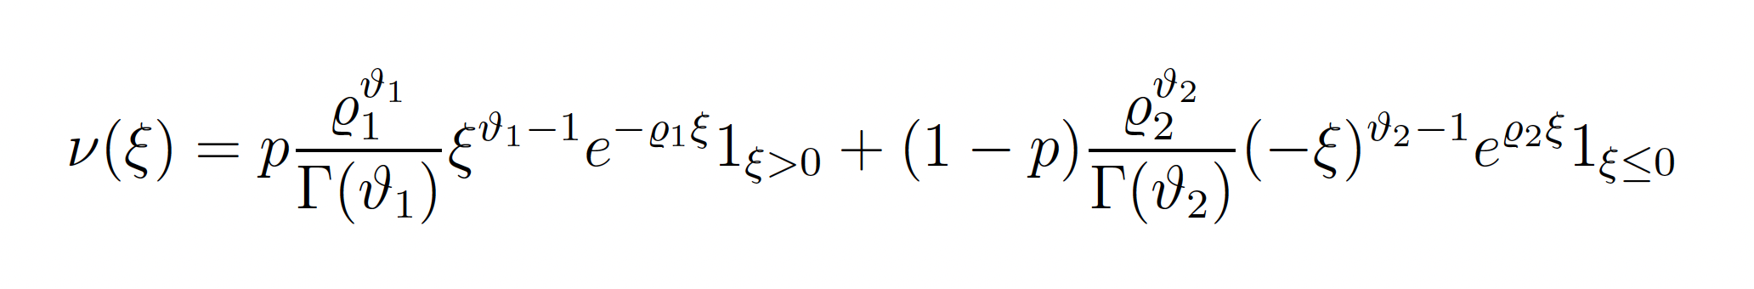
Motivation and notations
Double exponential distribution
Double gamma distribution

Slide 3
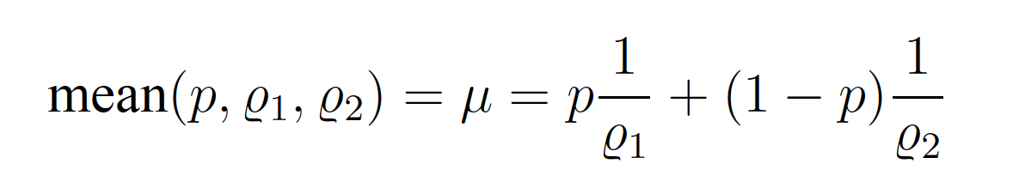
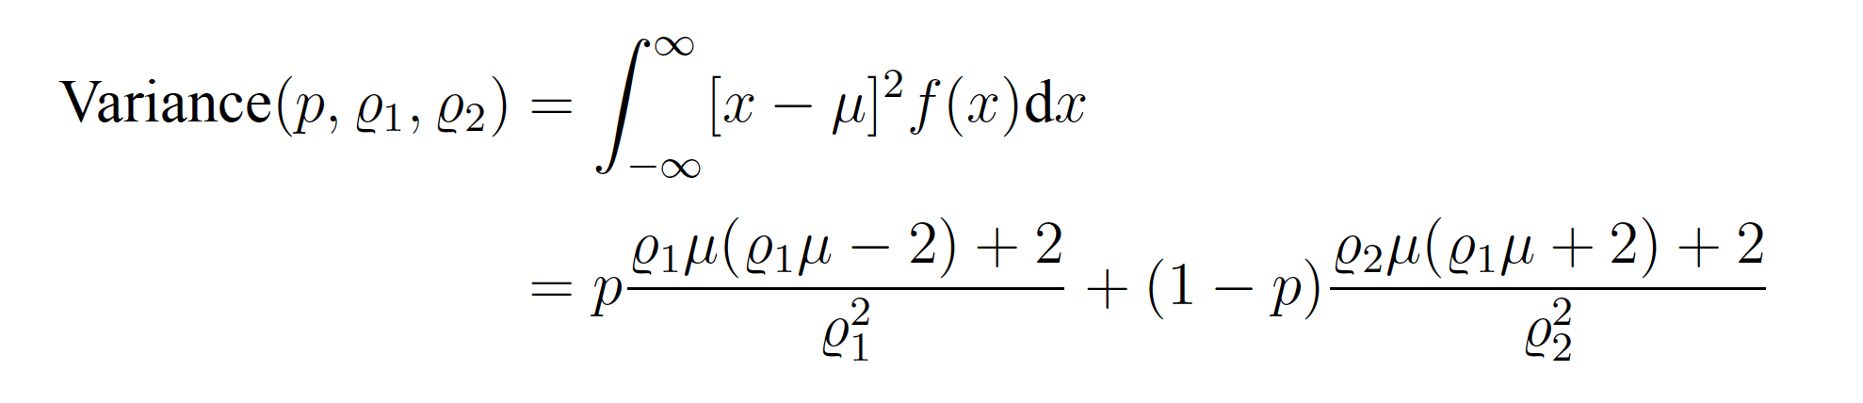
Moments of Double exponential
Notes:
This study aims to change the jump size distribution of Kou's jump diffusion model \cite{kou2004option} from a double exponential distribution to a double gamma distribution. Models are created to try and explain the market, but the financial market is not governed by natural laws like mathematics or physics; therefore, our goal is to try to create a model that simulates the behavior of the market as best we could. We know that the double exponential distribution has three parameters, $p$, $\varrho_{1}$, and $\varrho_{2}$. On the other hand, double gamma distributions has five parameters, $p$, $\varrho_{1}$, $\varrho_{2}$ and $\vartheta_{1}$, $\vartheta_{2}$, and setting $\vartheta_{1} = \vartheta_{2} = 1$ can replicate double exponential results. Therefore, the double gamma is more general. When the economy is good, we can increase the mean of the jump distribution to create more positive jumps. When the market is very volatile, we can increase the variance of the jump distribution to create more versatile jumps. But even if the economy is good, there will always be bad days, likewise, there will always be good days in bad economies, and by increasing $p$ we can increase the likelihood that jumps go up. We know that the mean and variance of the double exponential distribution is made up of the three parameters, so when the mean, variance and $p$ are determined, the parameters $\varrho_{1}$ and $\varrho_{2}$ are fixed. But for the double gamma distribution, the mean and variance are composed of five parameters, so if the mean, variance, and $p$ are determined, the system will be a two-equation system with four variables, giving us flexibility to adjust parameters to better fit the market. where the parameters of the double exponential distribution are fixed and may conflict with the market.

Slide 4
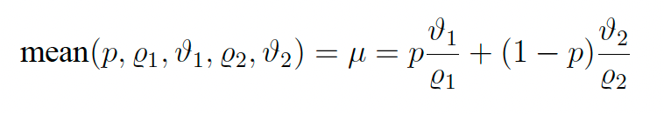
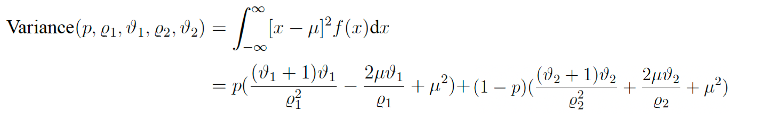
Moments of Double gamma

Slide 5
Introduction

Slide 6
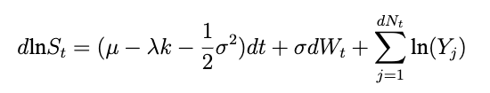
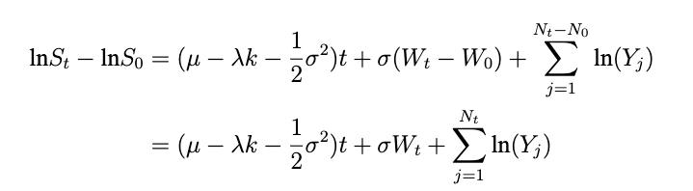
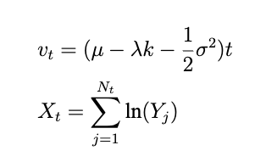
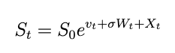
Jump diffusion model

Slide 7
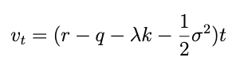
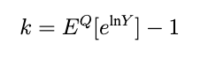
Martingale condition

Slide 8
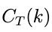
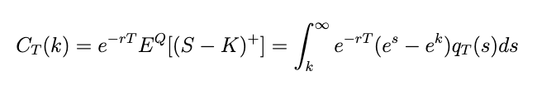
Fast Fourier Transform
: price of a European call option at maturity T
S = exp(s), K = exp(k)
: the risk neutral density of ln(S)
is not square integrable because converges to S₀ as k ⟶ ∞

Slide 9
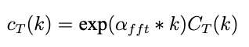
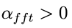
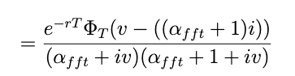
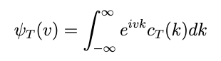
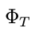
But if we modify it
Now c_{T} (k) is square integrable for a suitable
and. is the characteristic function of our jump diffusion model.

Slide 10
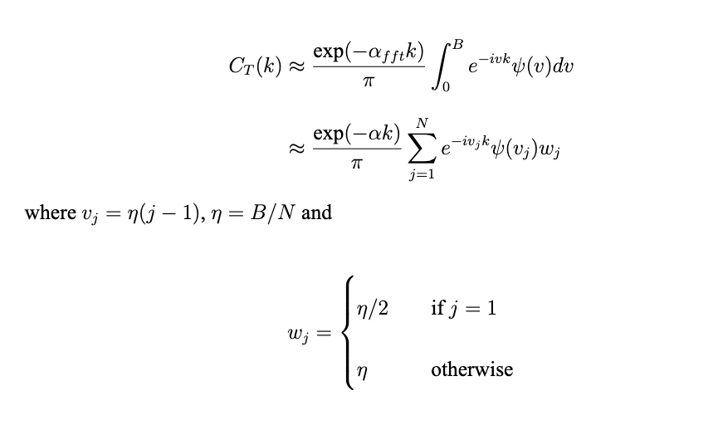
And with the use of the Trapezoidal Rules we get:

Slide 11
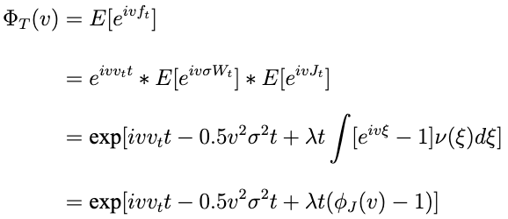
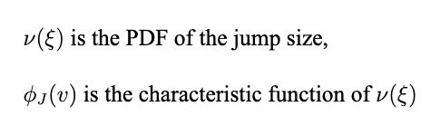
Characteristic function
General form:

Slide 12
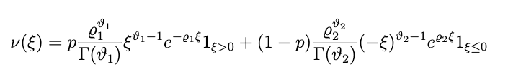
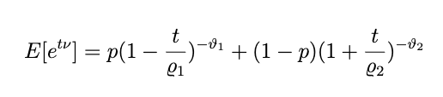
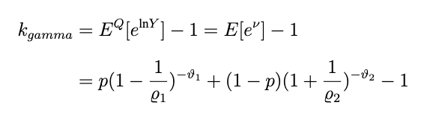
Double gamma Characteristic function
PGF:
MGF:
k_{gamma} :

Slide 13
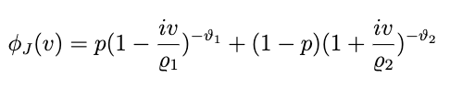
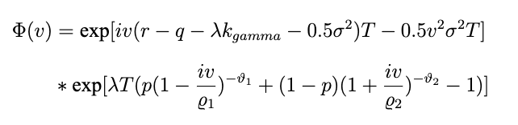
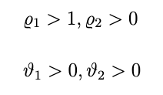
Characteristic function for double gamma distribution:
Therefore the model’s characteristic function

Slide 14
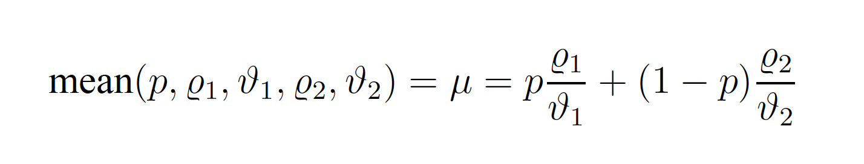
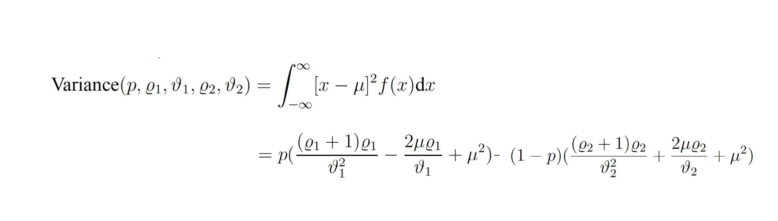
Double gamma distribution moments

Slide 15
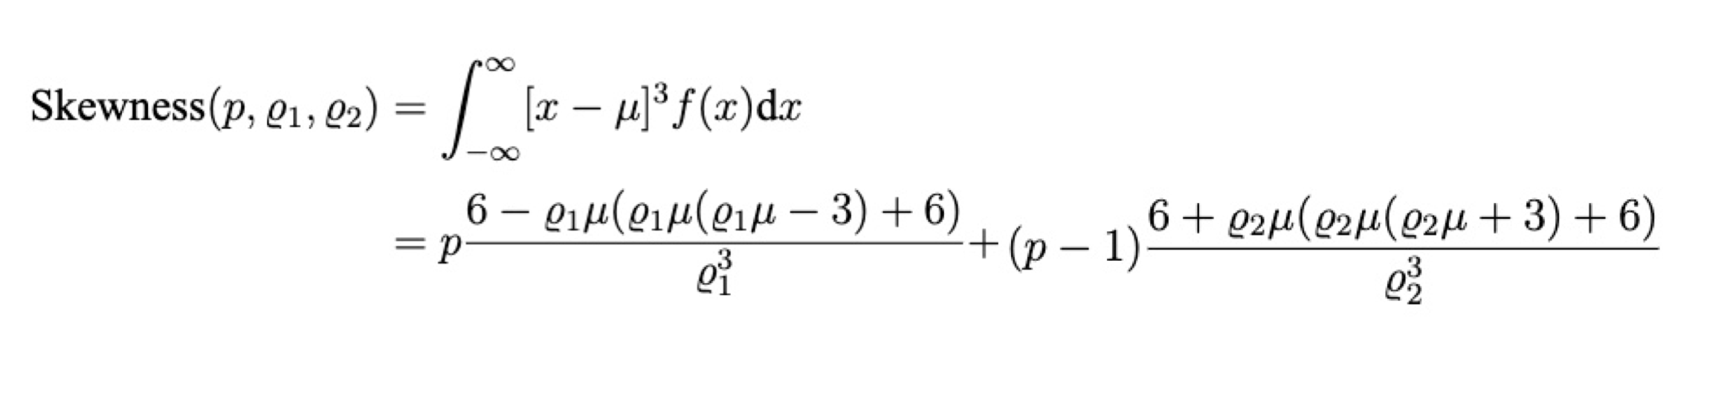
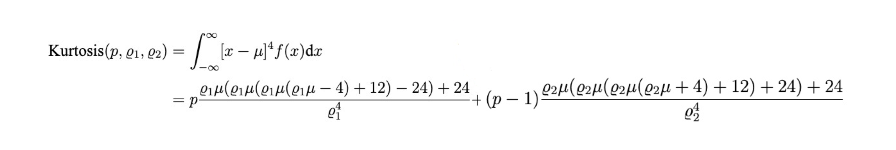

Slide 16
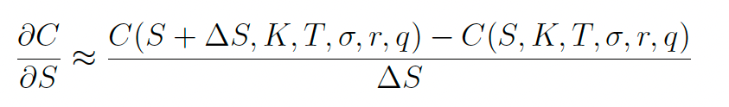
Methodology to calculate Greeks
Finite difference method
Delta: (Vega, Theta, Rho)
Gamma:

Slide 17
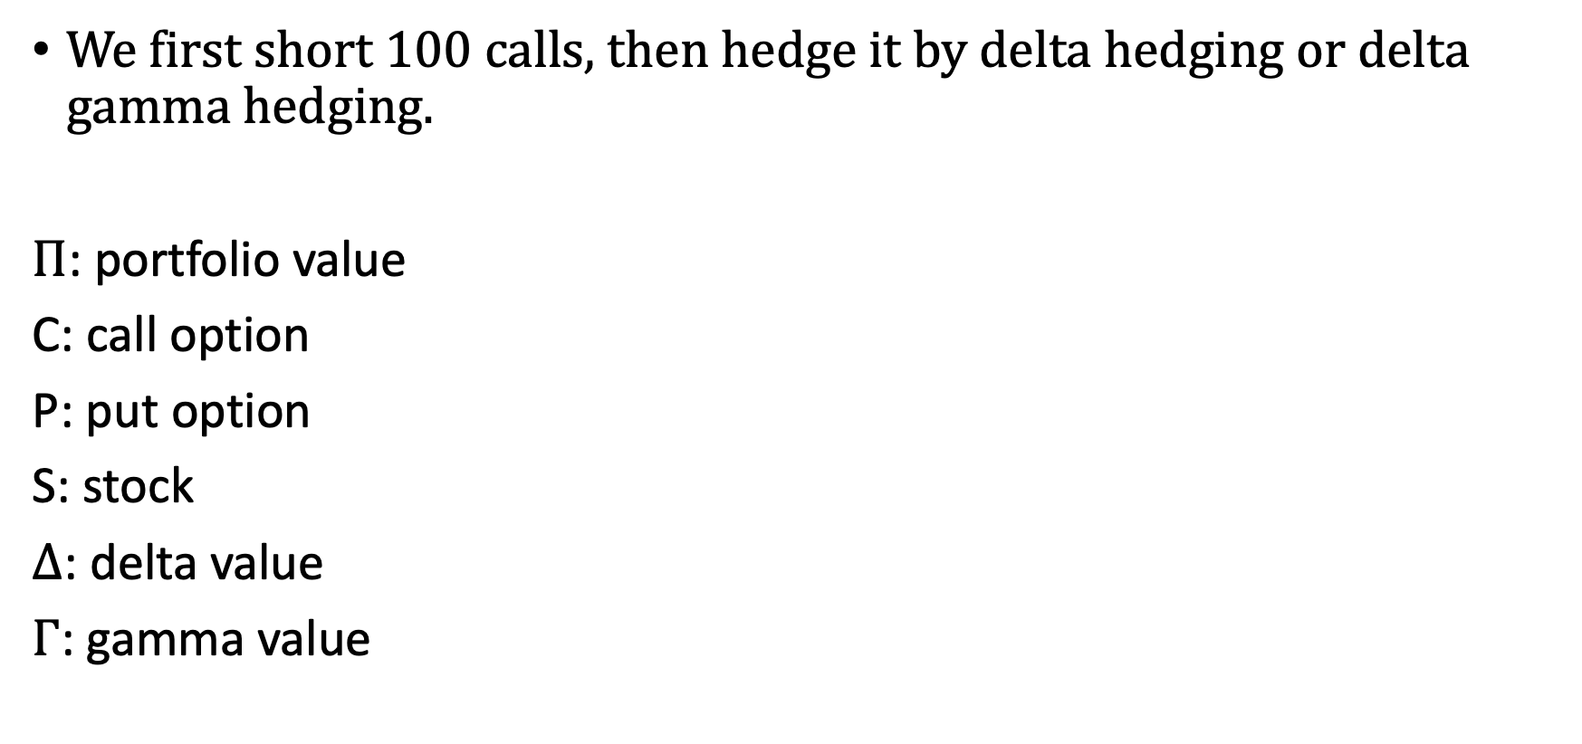
Greeks hedging
We first short 100 calls, then hedge it by delta hedging or delta gamma hedging.
$Π$: portfolio value
C: call option
P: put option
S: stock
$∆$: delta value
$Γ$: gamma value

Slide 18
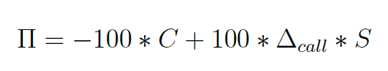
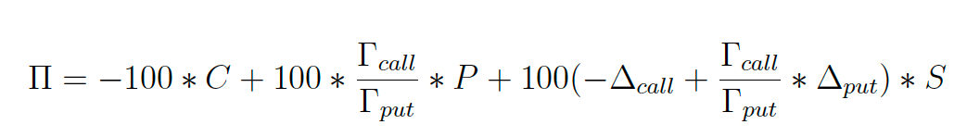
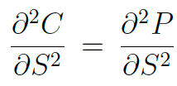
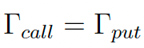
Delta hedging:
Delta gamma hedging:
by put call parity

Slide 19
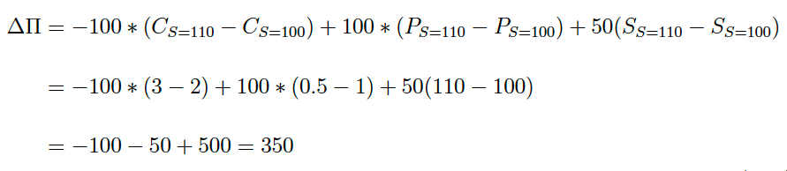
Change in portfolio value
T = 0
S = 100, K = 100, C = 2, P = 1, stock position = 50, call position = -100, put position = 100
T = 1
S = 110 , C = 3, P = 0.5

Slide 20
Double gamma jump diffusion model call value

Slide 21
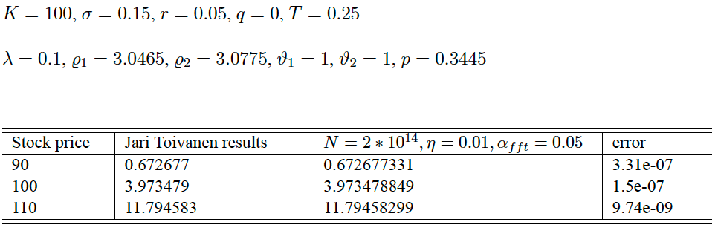
Sanity test
First we will compare our results with the results in Jari Toivanen (2008).

Slide 22
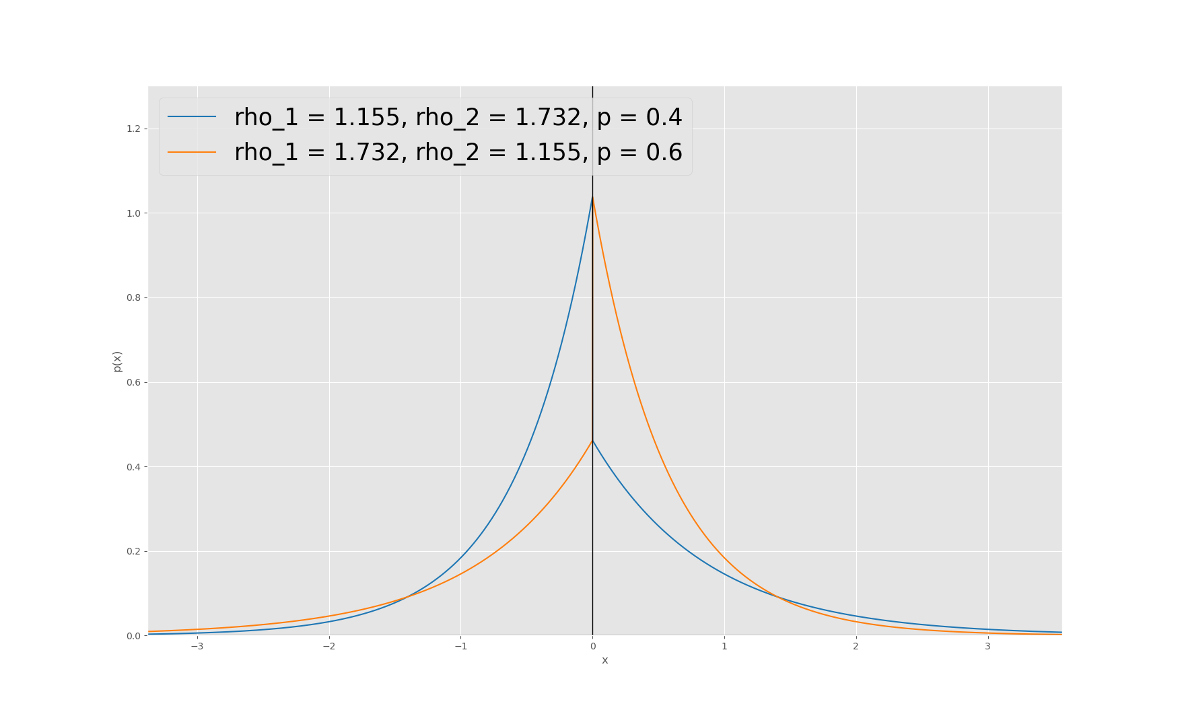
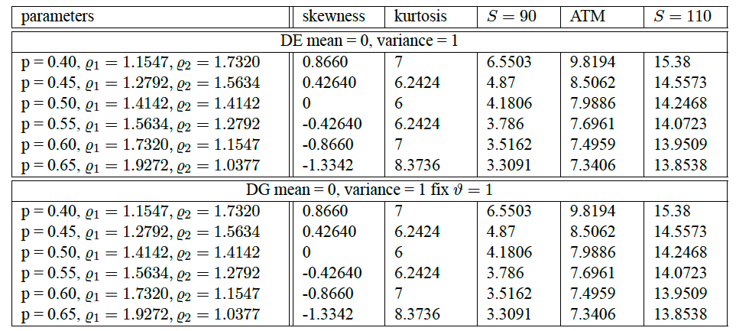
The result of DG call value under fixed mean and variance
DG distribution mean = 0, variance = 1

Slide 23
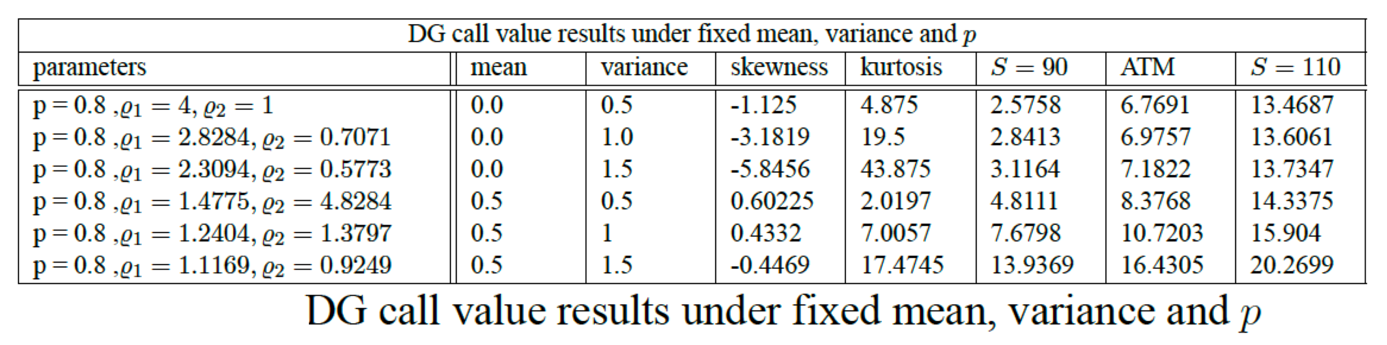
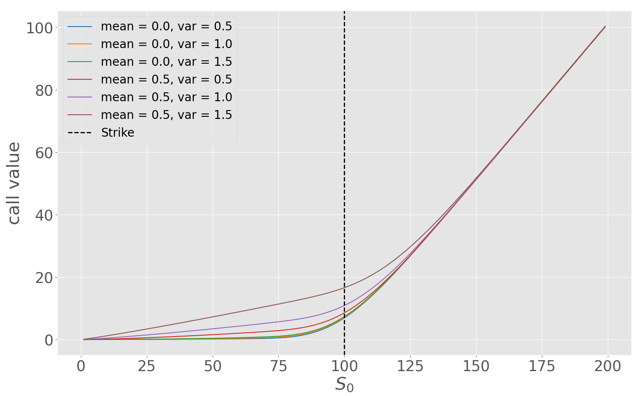

Slide 24
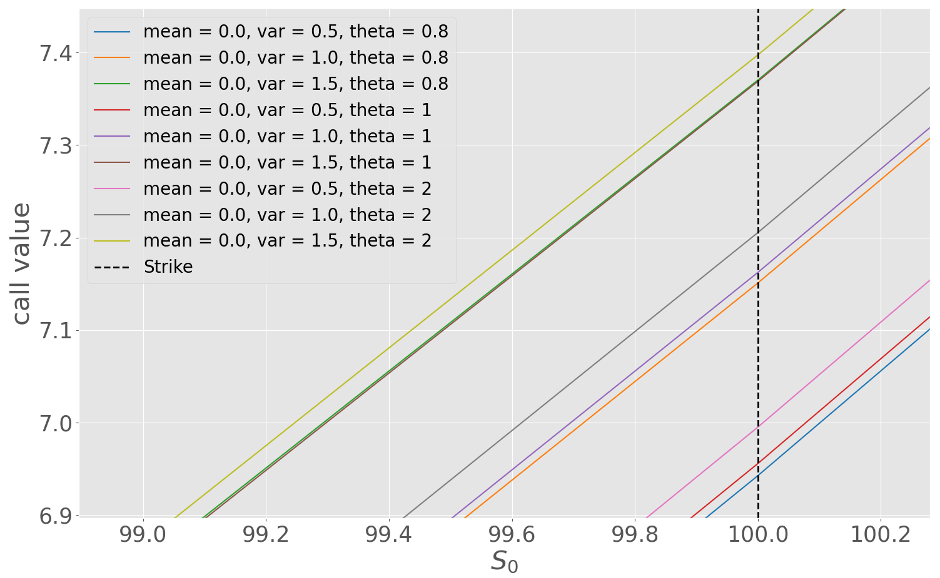
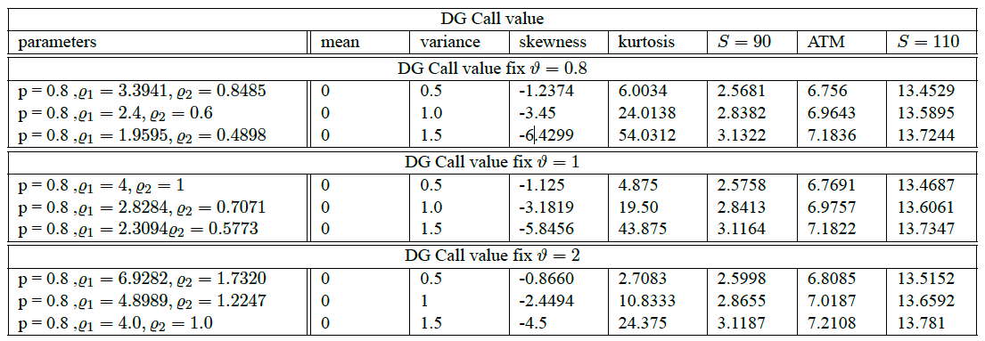
The result of DG call value under fixed mean and variance with different parameters

Slide 25
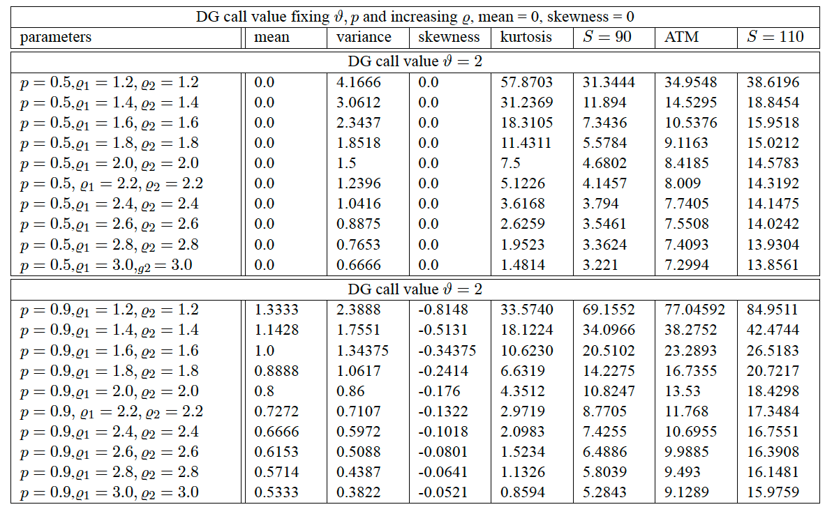
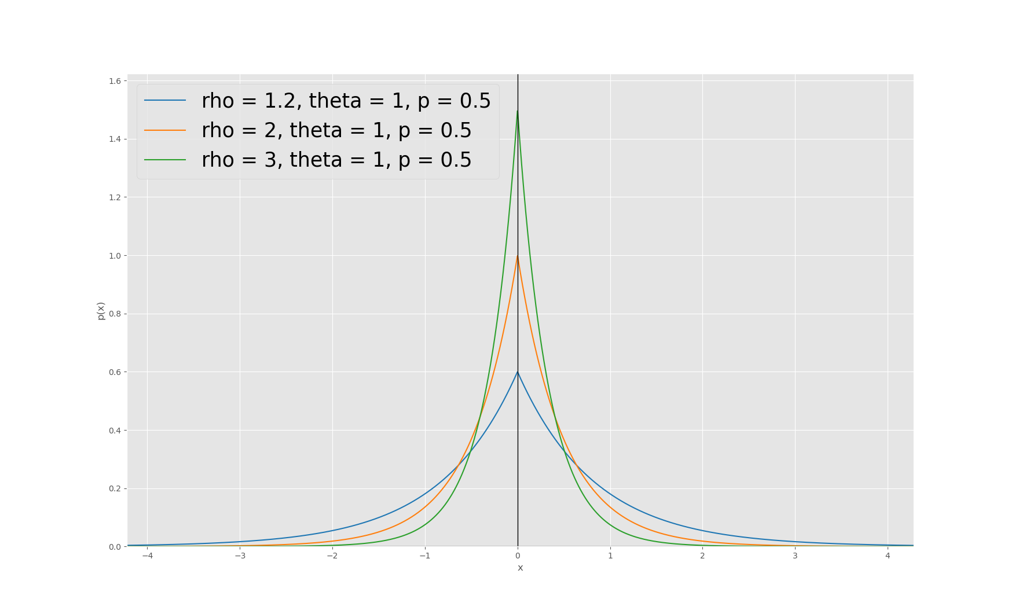
The result of DG call value under fixed ϑ, p, while changing ϱ

Slide 26
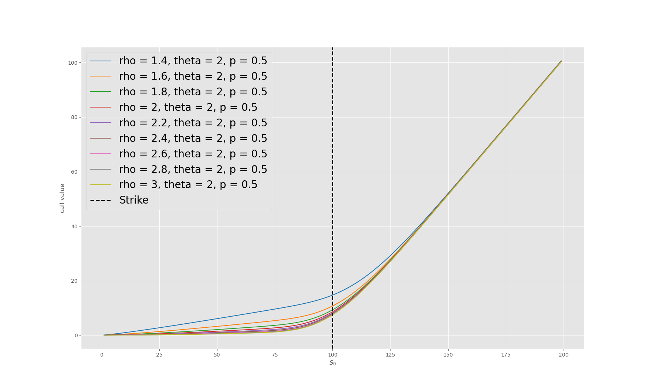
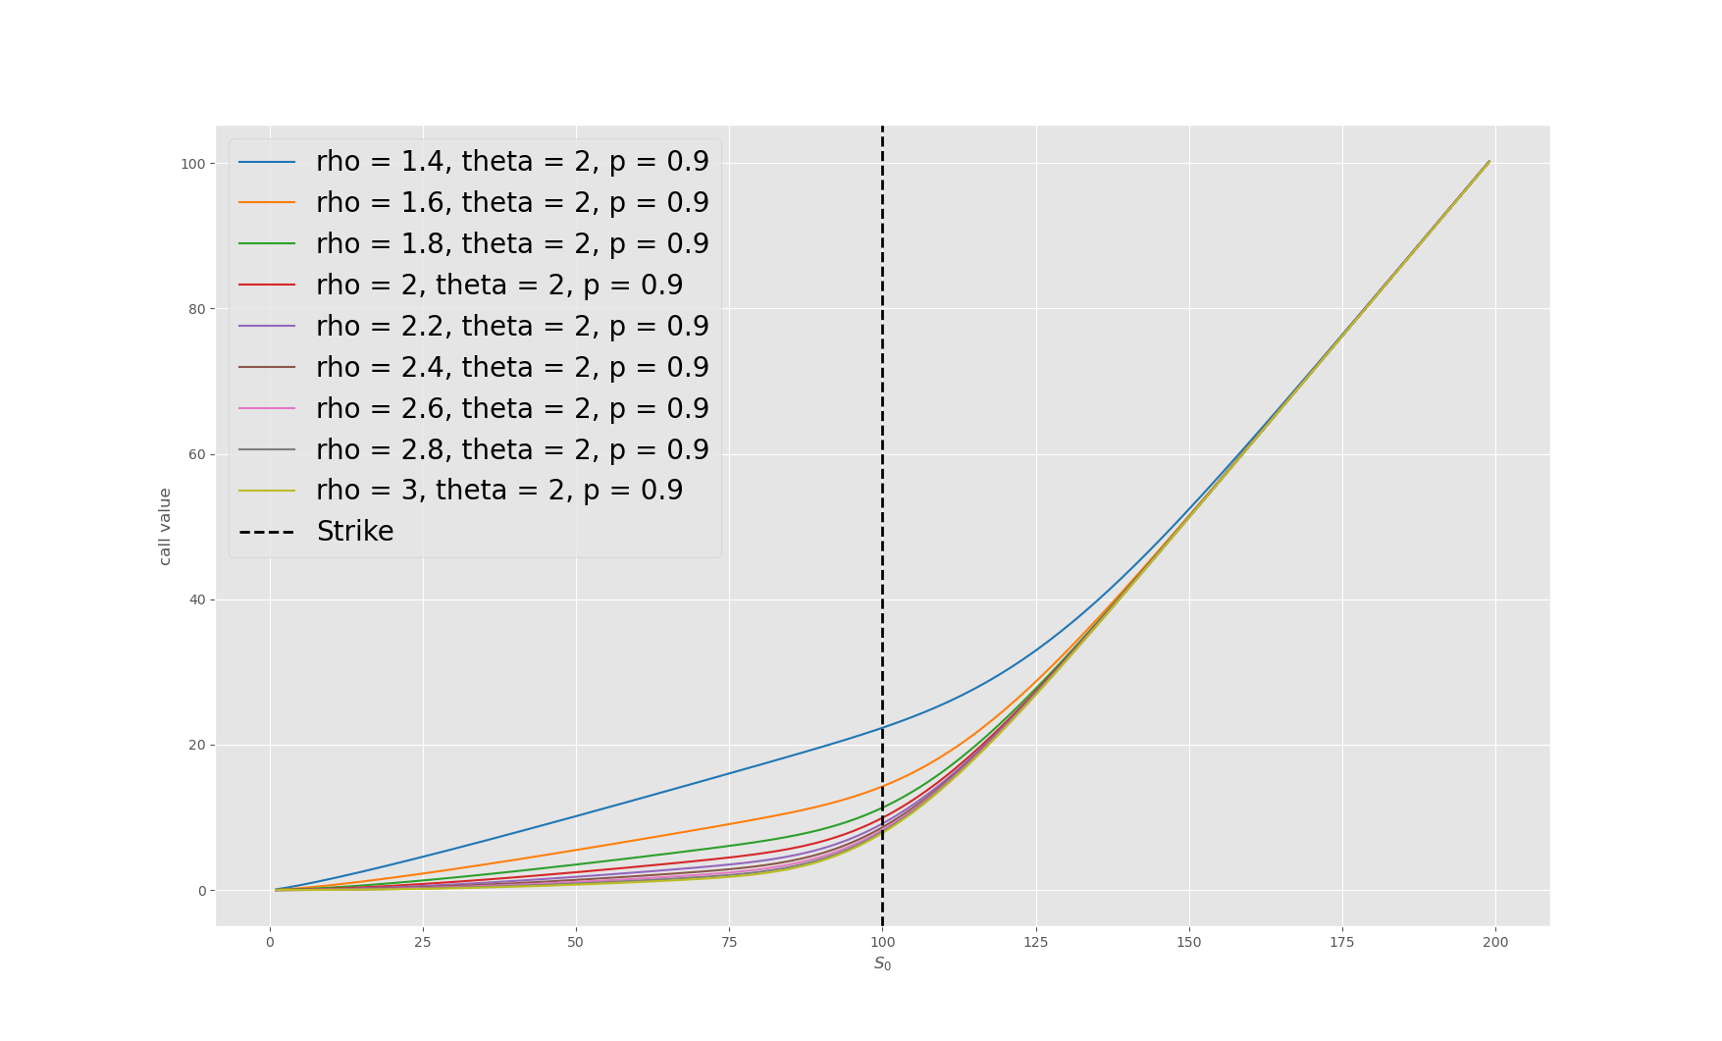

Slide 27


The result of DG call value under fixed ϱ, p, while changing ϑ

Slide 28



Slide 29


The result of DG call value under fixed ϑ, ϱ, while changing p

Slide 30



Slide 31


Slide 32
Call value conclusion
Larger the mean, variance, skewness, and kurtosis, the greater the call value.
The most important factor is the heavy tail.
Under fixed ϑ, p as ϱ increases, call value decreases.
Under fixed ϱ, p as ϑ increases, call value increases.
Under fixed ϱ, ϑ as p increases, call value increases.

Slide 33
Double gamma jump diffusion model Greeks

Slide 34

DG Greeks value results under fixed mean and variance

Slide 35


delta

Slide 36


gamma

Slide 37


vega

Slide 38


theta

Slide 39


rho

Slide 40



DG Greeks value results under fixed mean and variance with different parameters
delta

Slide 41



gamma

Slide 42



vega

Slide 43



theta

Slide 44



rho

Slide 45


DG Greeks value results under fixed ϑ, p while changing ϱ
delta

Slide 46


gamma

Slide 47


vega

Slide 48


theta

Slide 49


rho

Slide 50


DG Greeks value results under fixed ϱ, p while changing ϑ
delta

Slide 51


gamma

Slide 52


vega

Slide 53


theta

Slide 54


rho

Slide 55

DG Greeks value results under fixed ϑ, ϱ while changing p
delta

Slide 56

gamma

Slide 57

vega

Slide 58

theta

Slide 59

rho

Slide 60
DG Greeks value conclusion
We can see that as mean, variance, skewness, and kurtosis increase, the delta, gamma, vega and rho curves shift to the right, and the theta curves shifts downward.
Under fixed ϱ, p, as ϑ increases, the delta, gamma, vega and rho curves shift to the right, theta curves shift downward, and the less compact the curves are.

Slide 61
Under fixed ϑ, p, as ϱ increases, the delta, gamma, vega and rho curves shift to the left, theta curves shift upward, and the more compact the curves are.
Under fixed ϱ, ϑ, as p increases, the delta, gamma, vega and rho curves shift to the right, theta curves shift downward and the less compact the curves are.

Slide 62
Double gamma jump diffusion model Greeks hedging

Slide 63


DG Greeks hedging results under fixed mean and variance

Slide 64


delta hedging delta gamma hedging

Slide 65


DG Greeks hedging results under fixed mean and variance with different parameters
delta hedging

Slide 66

delta gamma hedging

Slide 67


DG Greeks hedging results under fixed ϑ, p while changing ϱ
delta hedging

Slide 68


delta gamma hedging

Slide 69


DG Greeks hedging results under fixed ϱ, p while changing ϑ
delta hedging

Slide 70


delta gamma hedging

Slide 71


DG Greeks hedging results under fixed ϱ, ϑ, while changing p
delta hedging

Slide 72


delta gamma hedging

Slide 73
DG Greeks hedging conclusion
Delta hedging
Delta hedging ΔΠ curves are like a quadratic function with an opening facing down, the larger the mean, variance, skewness and kurtosis, the more clockwise the ΔΠ curves rotate and the lower the stock position.
Under fixed ϱ, p the larger ϑ the less compact the ΔΠ curves are and the more clockwise the ΔΠ curves rotate.

Slide 74
Under fixed ϑ, p the larger the ϱ the more compact the ΔΠ curves and the more counter clockwise the ΔΠ curves rotate.
Under fixed ϱ, ϑ the larger the p, the less compact the ΔΠ curves are and the more clockwise the ΔΠ curves rotate and the.

Slide 75
Delta gamma hedging
Delta gamma hedging curves ΔΠ are like a linear function, so the values for S = 90 and S = 100 are the same but opposite in sign and the delta gamma hedging has a better hedging effect than the delta hedging.
The stock position and hedging effect do not really change in relation with the change in mean, variance, skewness and, kurtosis, ϱ, ϑ and p. Why?

Slide 76



Gamma value for call and put option:
Put call parity

Slide 77


